Slide 1
205 Oct 21, Class 11
Planning Experiment 2
Chapter 10
  2x2 results, main effects and interactions

Slide 2
Experiment 2
Feedback & Suggestions?
Hypotheses/Predictions
What might be the main effect of Meaning?
What might be the main effect of Encoding?
What interactions might we see?

Slide 3
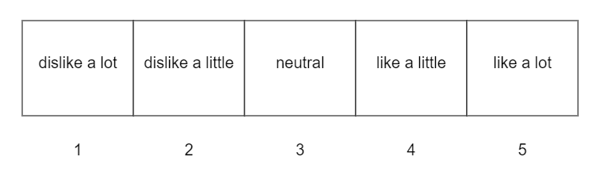
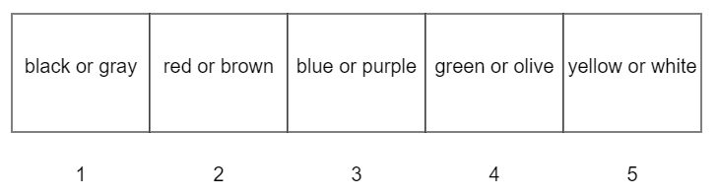
Rating scales
Deep encoding
Liking rating
Shallow encoding
Most prominent color

Slide 4

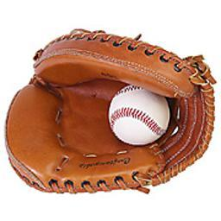
Experiment 2 Design
 |  | Meaningful
 |  | Abstract | Object
Encoding | Shallow | Color? | Color?
 | Deep | Liking? | Liking?

Slide 5
For Wed Oct 23
Chapter 11: External Validity, Sampling
  Short introduction to the general idea
Assefi & Garry (2003). More 2x2 design practice.
Collect data for Experiment 2
  Try to get 4 people to volunteer to try the study
    Submit completion codes if they provide them
  Deadline: Friday night
    Assignment extended through weekend if needed

